Slide 1







Data-Driven Content Strategy:
Optimizing Netflix's Library
An Analysis of the Netflix Content Catalog
(Data Science Project)
Shagun Ratan
24201010140

Slide 2


DATA CLEANING
Data Exploration & Cleaning Summary
RAW DATA
CLEAN DATA
Netflix Titles (Approx. 8,800 records, 12 columns).
Data Set
Initial Check: Missing values in key fields (director, cast, country, date_added, rating).
Data Quality
* Filling Missing Data: Used 'Unknown' for non-critical text fields. * Removing Incomplete Data: Dropped rows missing date_added or rating to ensure accurate trends. * Date Correction: Cleaned extra spaces in date fields (.str.strip()) to fix parsing errors. * Feature Preparation: Split duration into numeric minutes (Movies) and seasons (TV Shows).Visual
Fix/Clean Actions

Slide 3
Content & Format Strategy
Key Points:
— Library is 70% Movies, only 30% TV Shows.
— High-risk TV-MA content is mainly in TV Shows.
— Movie length is stable (90-100 min) .
Recommendation:
— Balance the Mix: Make more TV Shows to encourage binge-watching.
— New Format: Test 80-minute "snackable" films for mobile users

Slide 4
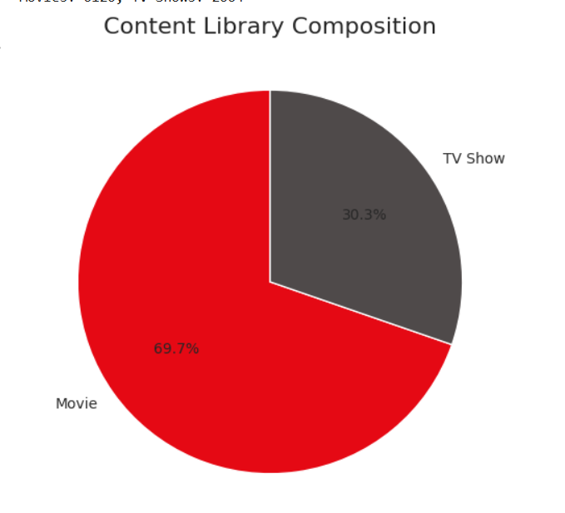

Slide 5
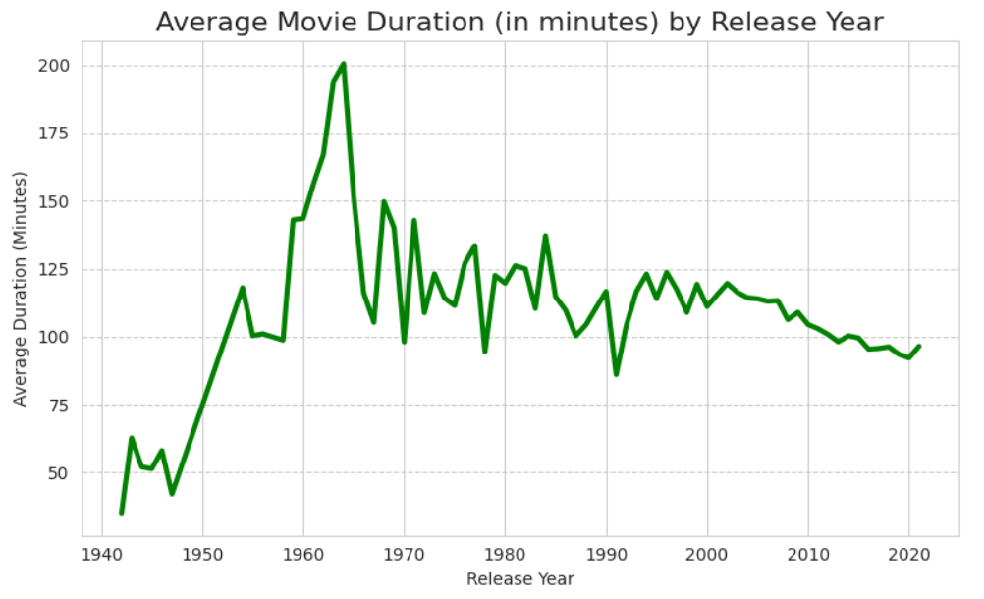
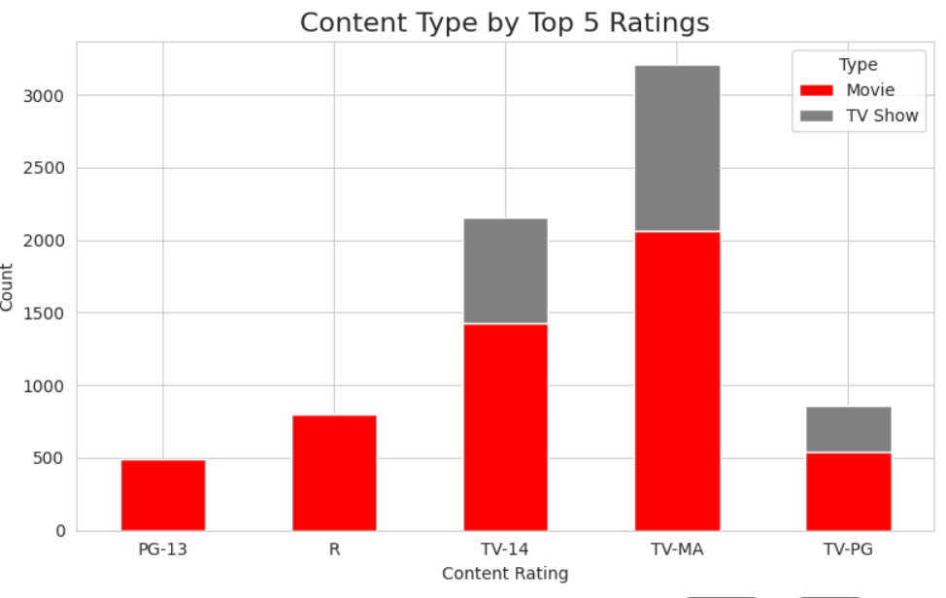

Slide 6
Audience & Genre Focus
Key Points:
— Core audience watches TV-MA (Mature) and TV-14 (Older Teens).
— Most content is safe (Dramas, Comedies).
Recommendation:
— Audience Focus: Keep making TV-MA/Adult content for the core audience.
— Niche Growth: Invest more in less crowded, high-demand genres like Sci-Fi and Fantasy to attract new subscribers.

Slide 7
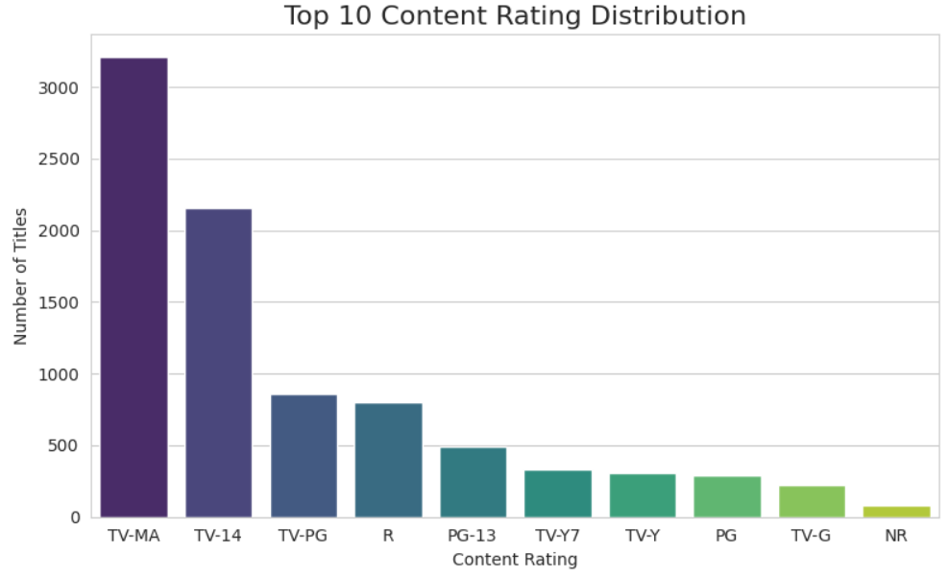
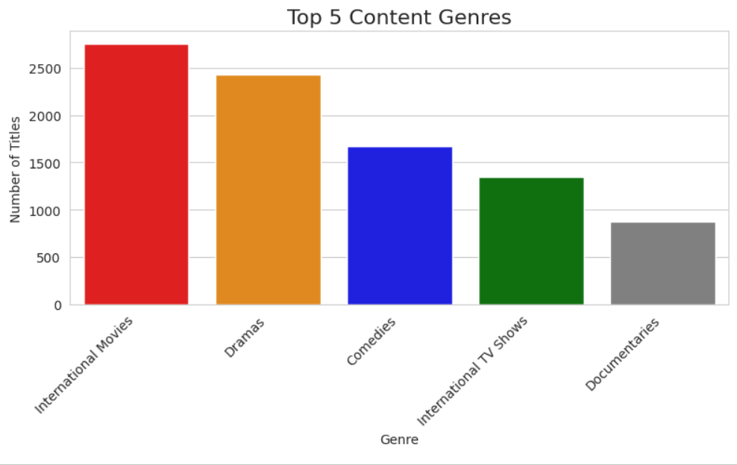

Slide 8
Library Growth & Age
Key Points:
— New titles added peaked in 2019 and have slowed down.
— We acquire brand new and older content (around 5 years old).
Recommendation:
— Maintain Balance: Continue the strategy of buying older films for library depth AND producing many high-quality originals (freshness) to keep the library appealing.

Slide 9
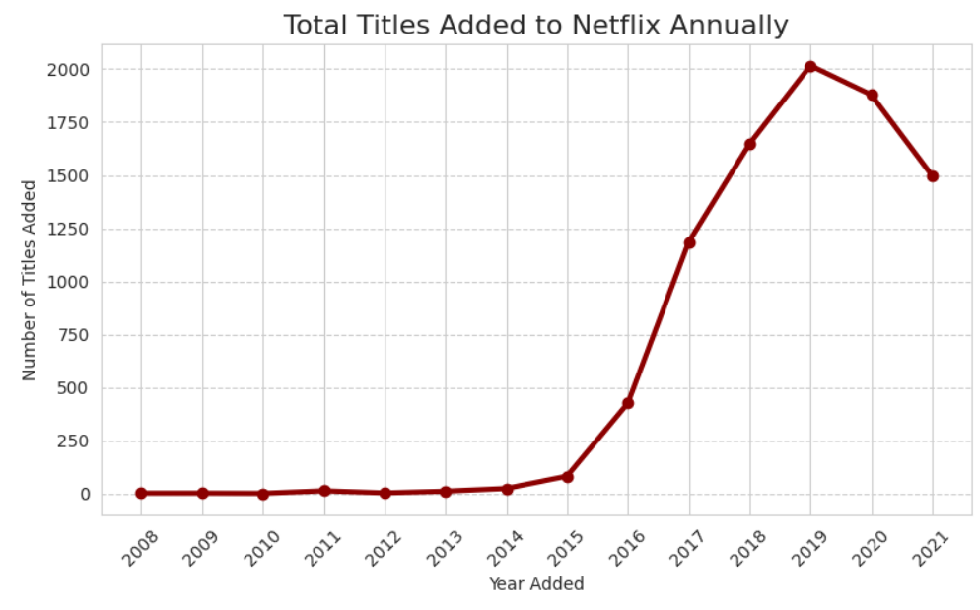
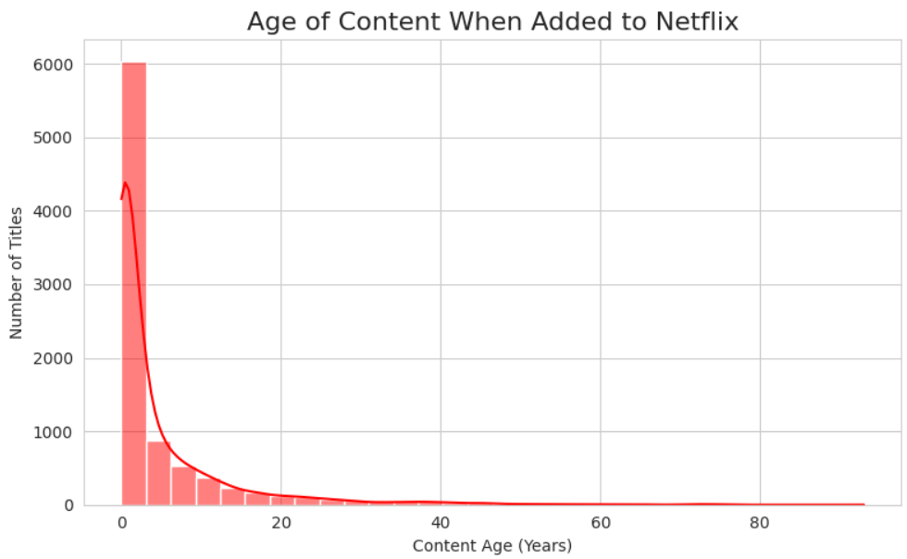

Slide 10
Talent Strategy
Key Points:
— Director and Actor talent is highly diversified; no single person dominates.
Recommendation:
— Acquisition: Sign the few top-performing people to long-term deals to guarantee a stream of popular work.
— Marketing: Focus promotion on local actors who are popular in specific regions rather than relying only on global stars.

Slide 11
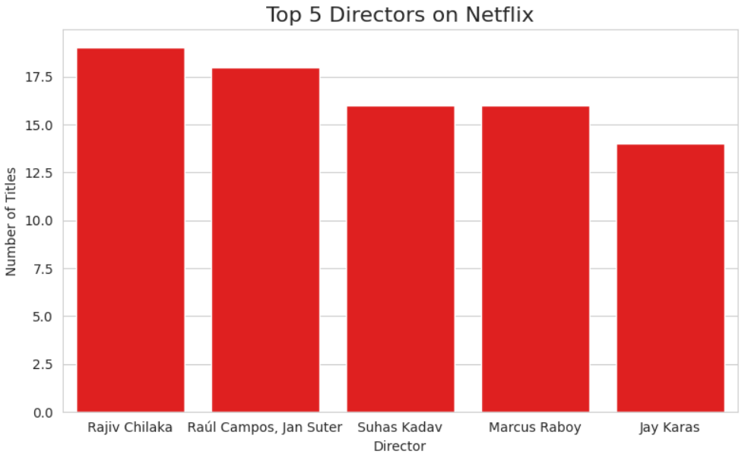
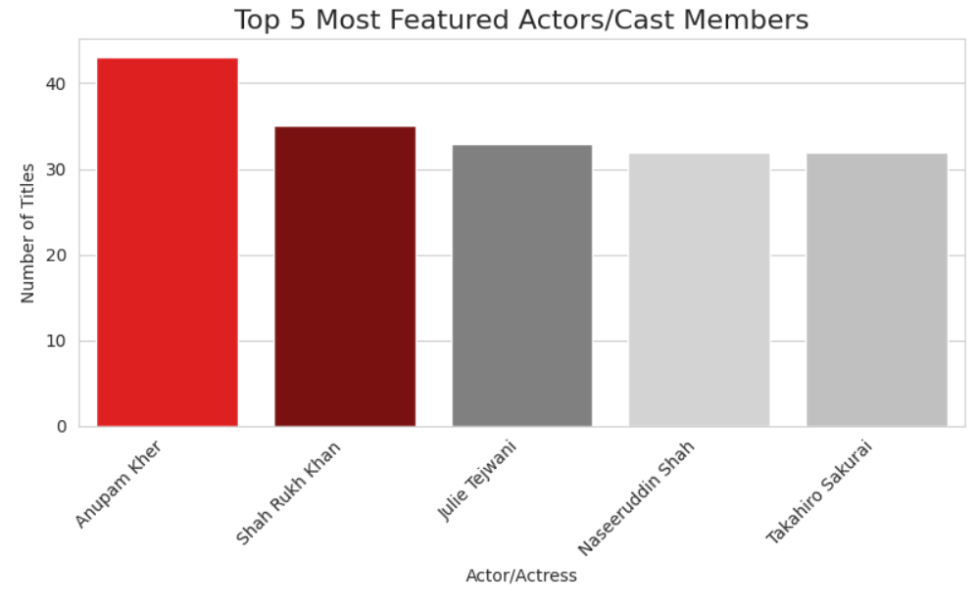

Slide 12
Market Focus
Key Points:
— The U.S. leads, but India is the strongest second in content production.
— Content production from India has grown exponentially since 2017.
Recommendation:
— India is the future. Increase funding and marketing for local Indian content to make Netflix the leader in that massive and growing market.

Slide 13
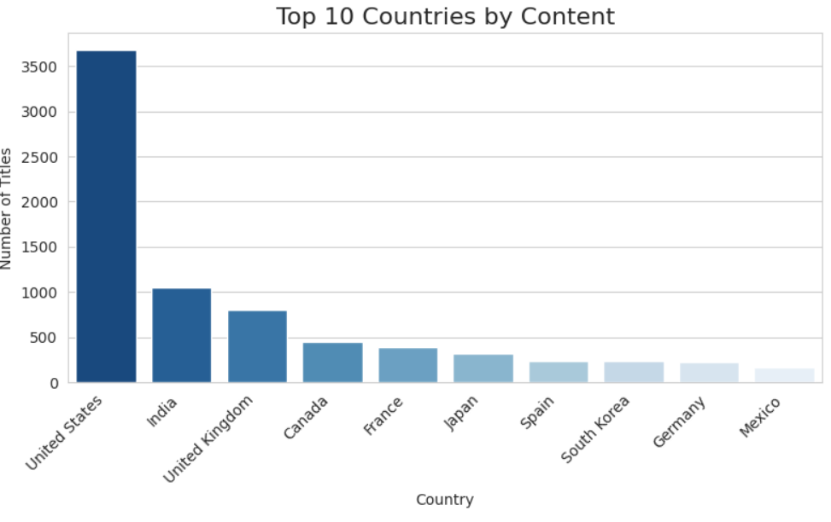
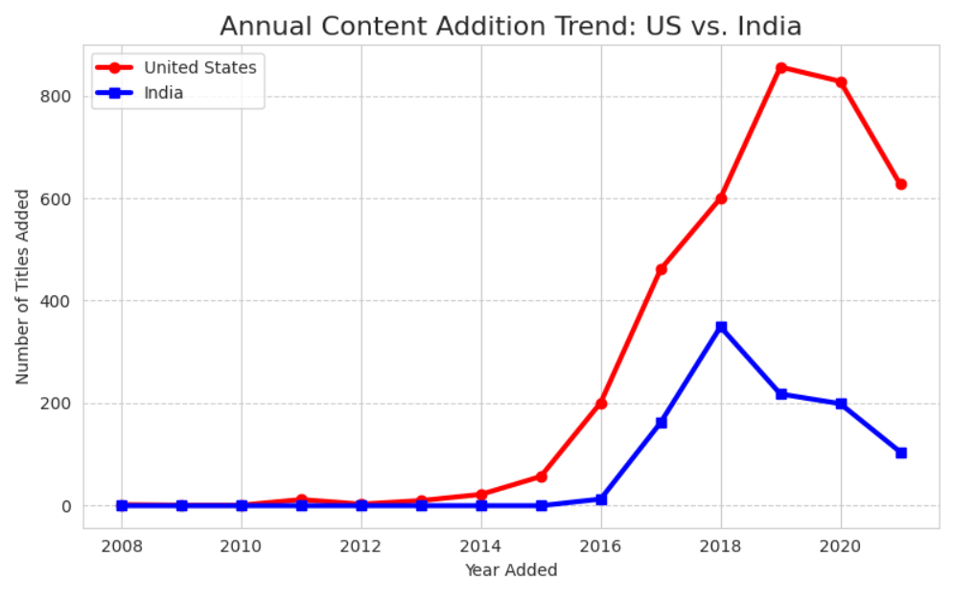

Slide 14
Release Timing
Key Points:
— Content additions are highest in December, with October and November also very strong.
Recommendation:
— This timing is smart. Always launch the biggest shows and movies in October, November, and December, as that is when people are watching the most.

Slide 15
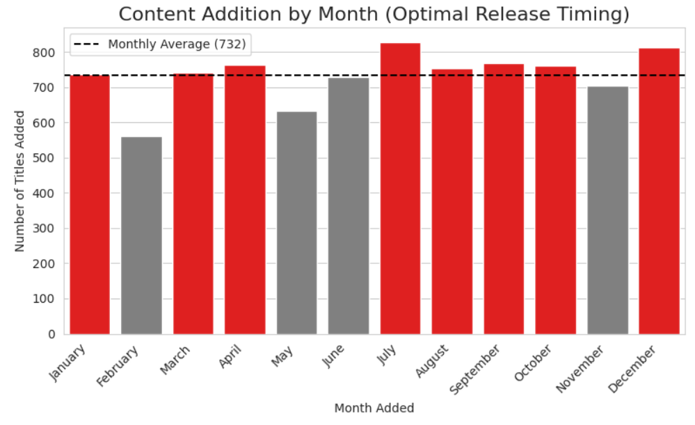

Slide 16
The 4 Big Takeaways
1. Content Mix: Balance out the Movies by making more TV Shows.
2. Market Focus: India is the biggest growth area—invest there.
3. Audience: Continue to make content for the Adult/TV-MA audience.
4. Timing: Always launch your biggest titles at the end of the year (October - December).

Slide 17
Conclusion
We can now use these data-backed ideas to build a smarter content budget and marketing strategy for next year.
https://colab.research.google.com/drive/1zt7uZJd0fQja4LL10oVrIg6fLCu7_SO0#scrollTo=emp6v86ThepL
Google Colab Link:

Slide 18
THANK YOU!!!

